Slide 1
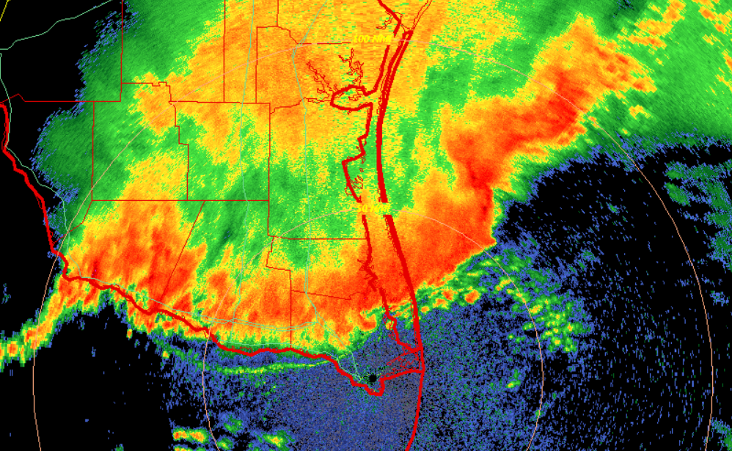
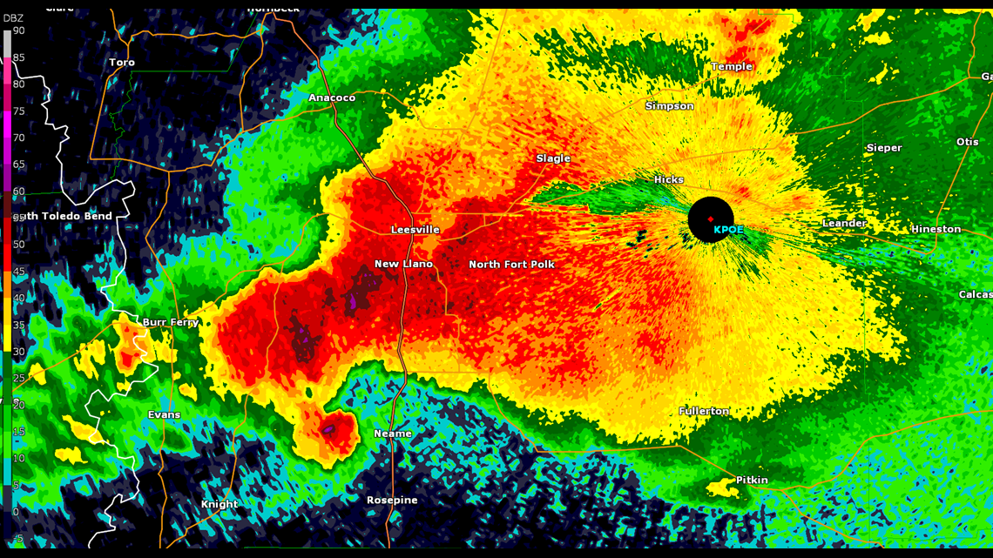
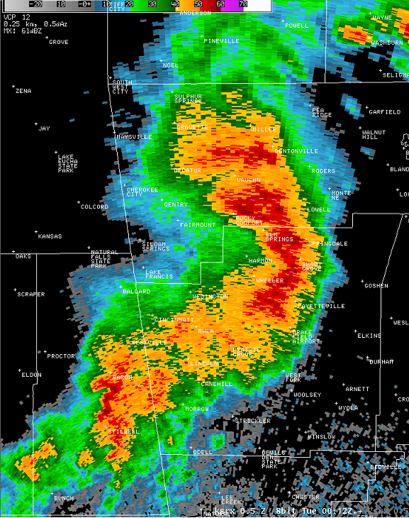
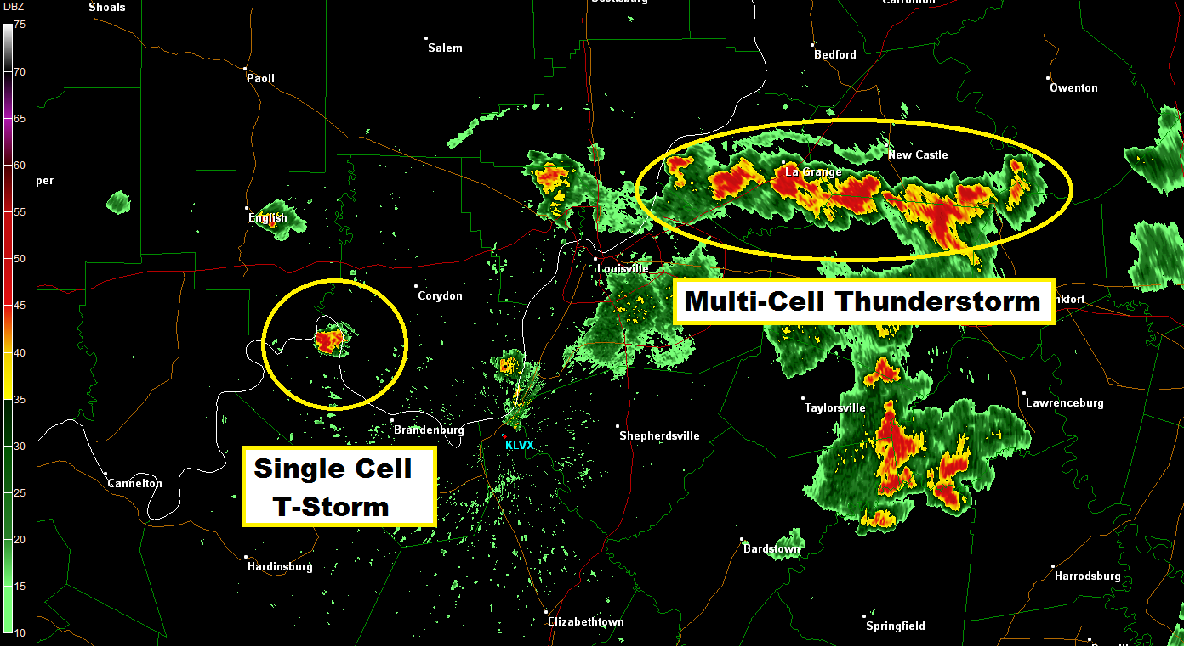
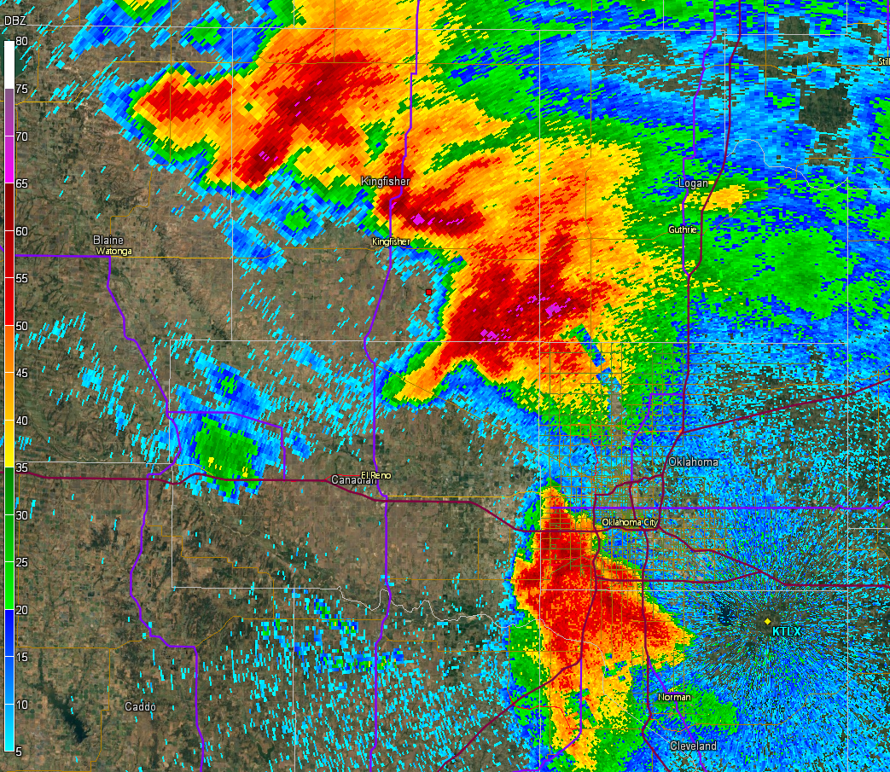
Storm Mode Exercise

Slide 2
Storm Mode Basics
All of these must be taken into account to anticipate storm mode for the first few hours after convective initiation.
Consider each of these:
Boundary-relative storm motion
Boundary-relative deep-layer shear
Storm-relative anvil-level winds
Strength of forcing for ascent
Strength of capping
Numerous combinations are possible!

Slide 3
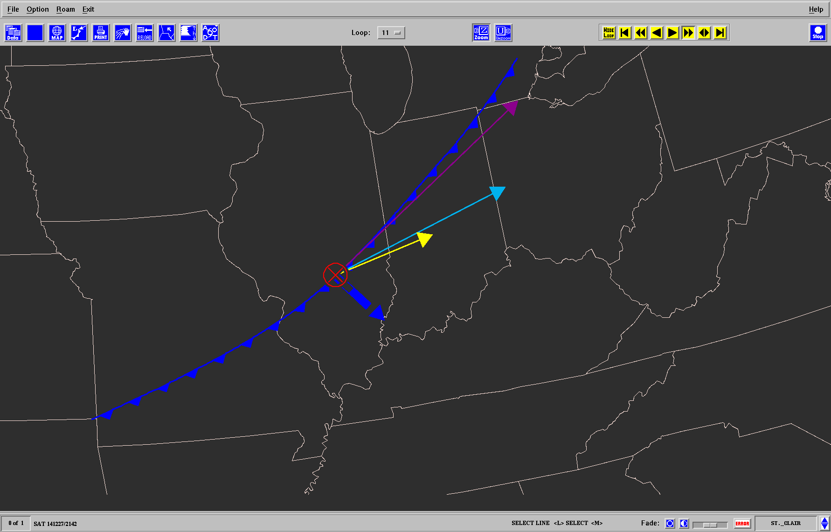
Vector-boundary orientation
Setup Favoring Linear Convection
9-11 km SR wind
Zone of Forced ascent
0-6 km shear vector
Boundary motion
Storm motion

Slide 4
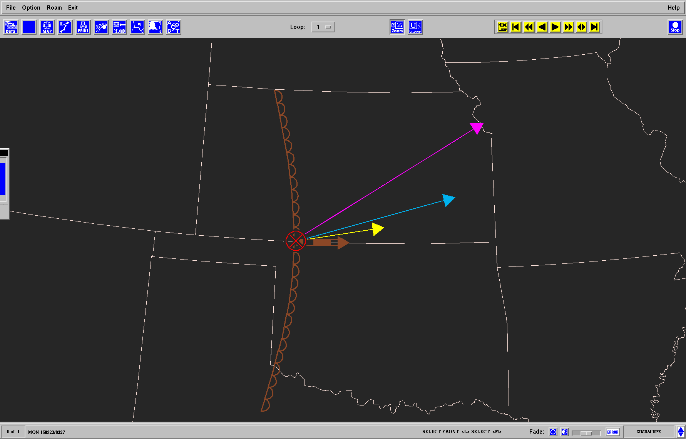
Setup Favoring Discrete Convection
9-11 km SR wind
0-6 km shear vector
Zone of Ascent
Storm motion
Boundary motion

Slide 5
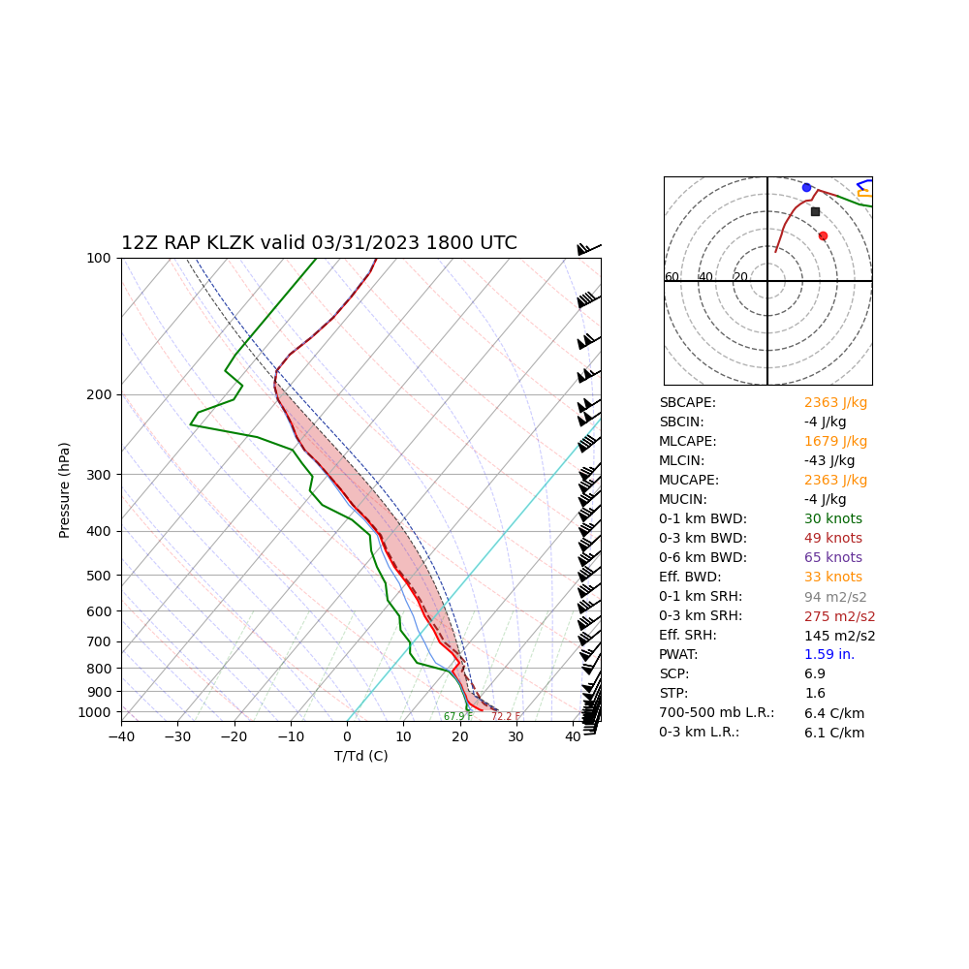
Case 1: What storm mode do you expect?
L
KFAR

Slide 6
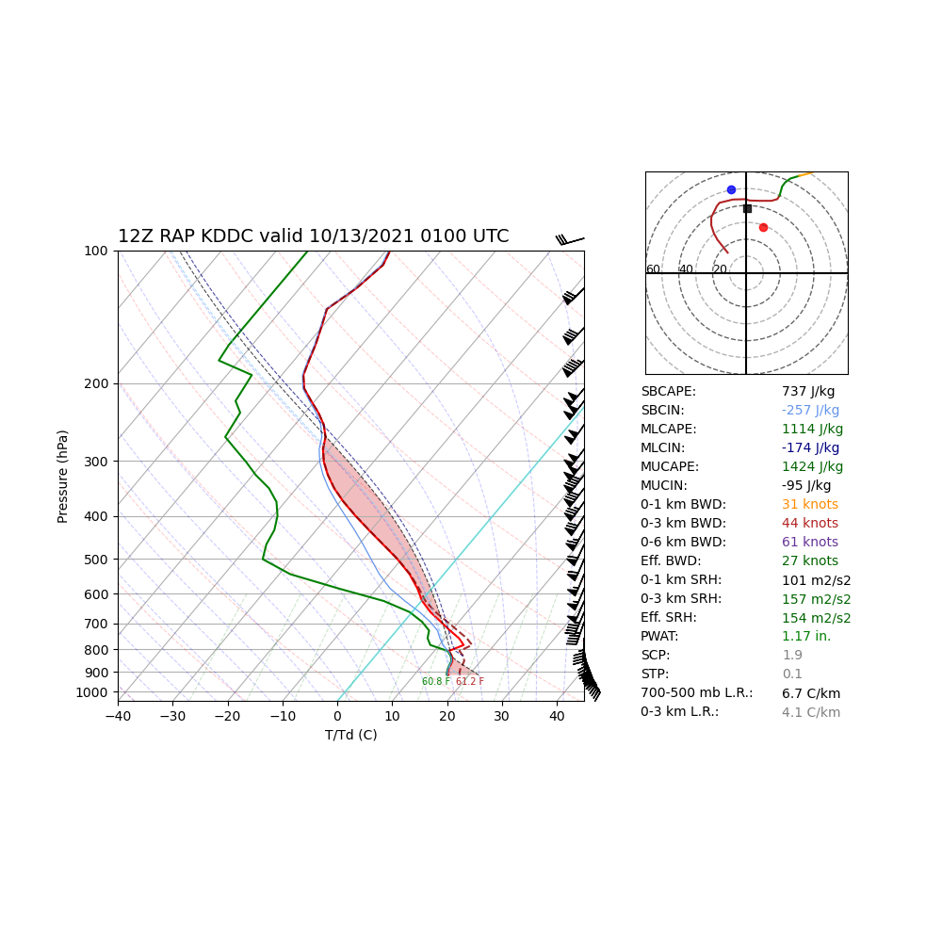
Case 2: What storm mode do you expect?
KFAR
L

Slide 7
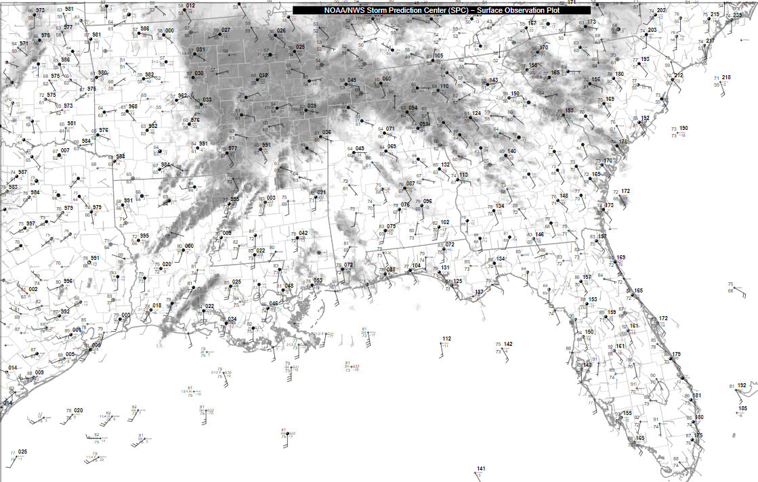
Case 3:
Where are the relevant boundaries?
How expansive is the warm sector?

Slide 8
L
L
65 F
70 F
Example 3:
Where are the relevant boundaries?
How expansive is the warm sector?
75 F

Slide 9
L
L
65 F
70 F
Here’s the warm sector!
Now how about storm mode?
75 F

Slide 10
L
6 km wind
L
65 F
B
C
D
70 F
A
Given the storm motion vectors shown
(black arrows) and assuming southwesterly flow aloft (blue arrow)…
a discrete storm will have the highest potential to remain discrete (1+ hour) at which point?
75 F

Slide 11
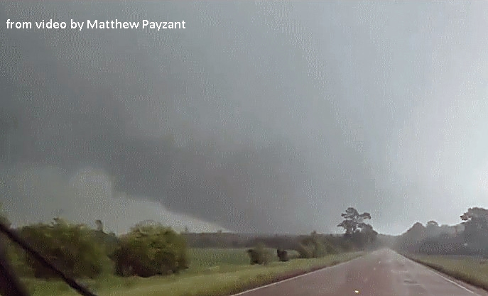
L
6 km wind
L
65 F
70 F
A
04/12/2020 18 UTC sfc obs
Multiple EF-3+ tornadoes hours later
75 F

Slide 12
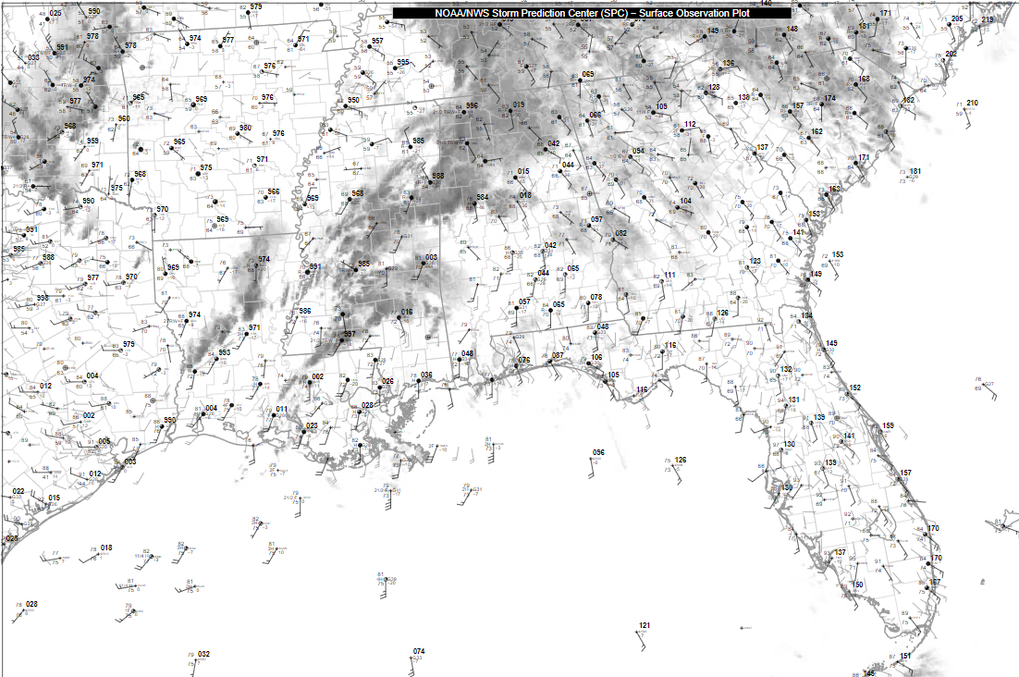
Warm Sector Geometry and Residence Time
L
L
65 F
70 F
75 F
Let’s step forward in time to 21 UTC…
75 F

Slide 13
Warm Sector Geometry and Residence Time
L
6 km wind
L
C
65 F
B
70 F
A
Given the storm motion vectors shown
(black arrows) and assuming southwesterly flow aloft (blue arrow)…
a discrete storm will have the highest potential to remain discrete (1+ hour) at which point?
75 F
75 F

Slide 14
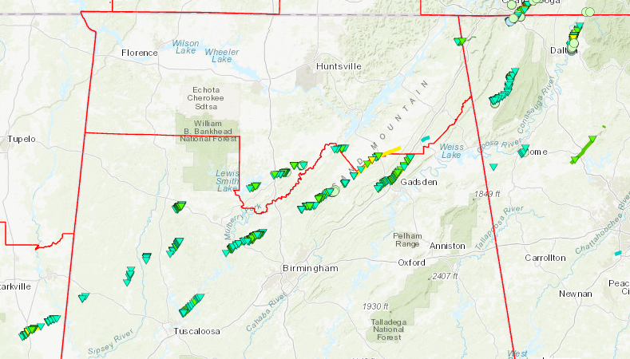
Warm Sector Geometry and Residence Time
L
6 km wind
L
C
65 F
B
70 F
A
Multiple EF-0/1s
2 EF-2s
75 F
75 F

Slide 15
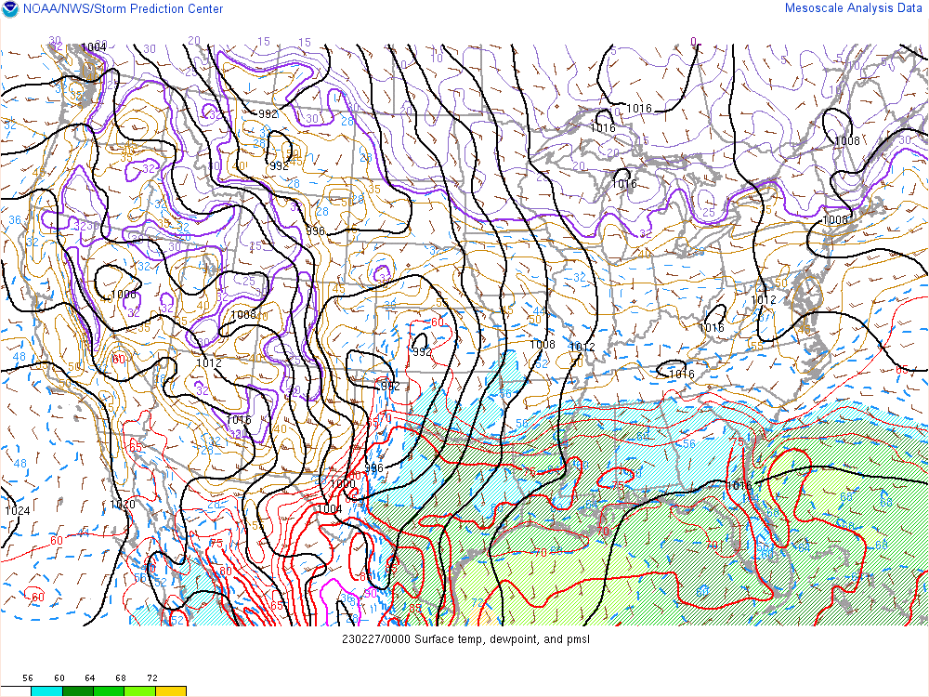
Case 4

Slide 16
First, Identify the boundaries!

Slide 18
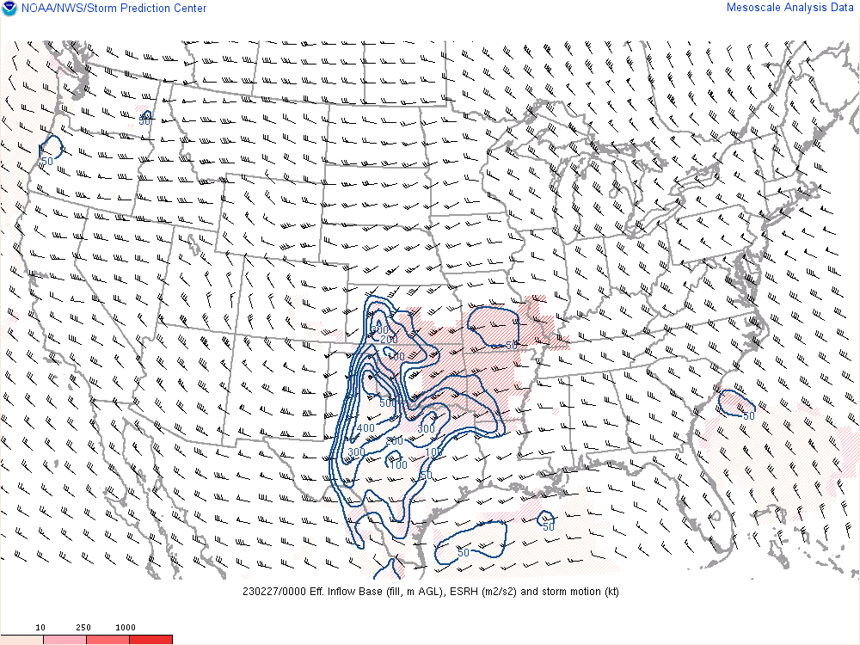
Bunker’s right-mover storm motion

Slide 19
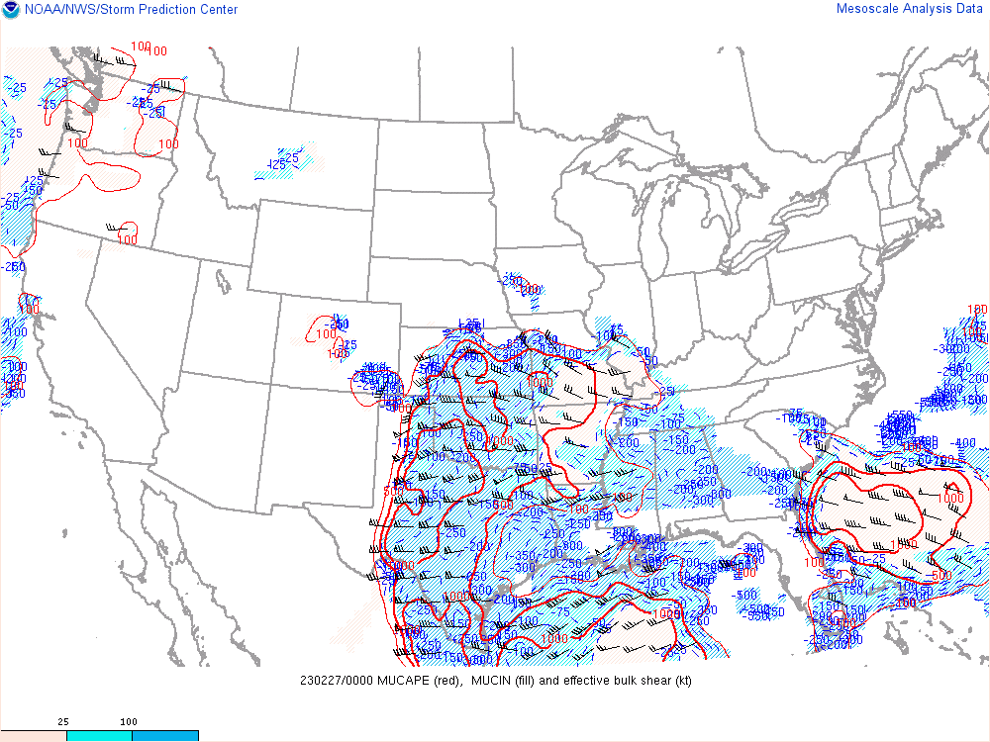
Effective Bulk Shear, MUCAPE/CIN

Slide 20
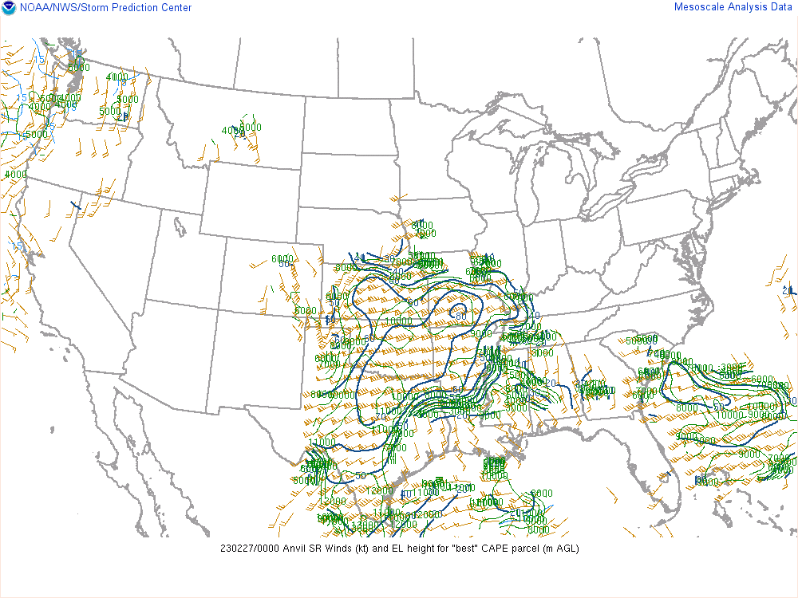
Anvil-level Storm-relative winds

Slide 21
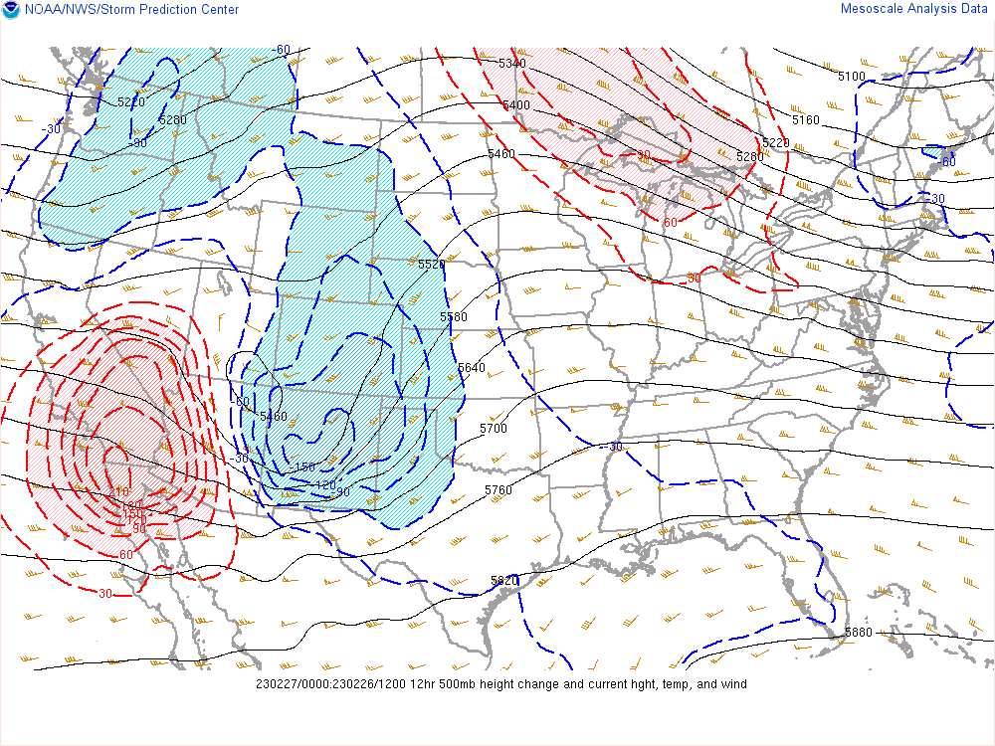
500 mb 12-hour height change

Slide 22
Assessment time!
What storm mode(s) do you expect?
Will the storm mode change within 2-4 hours?

Slide 23
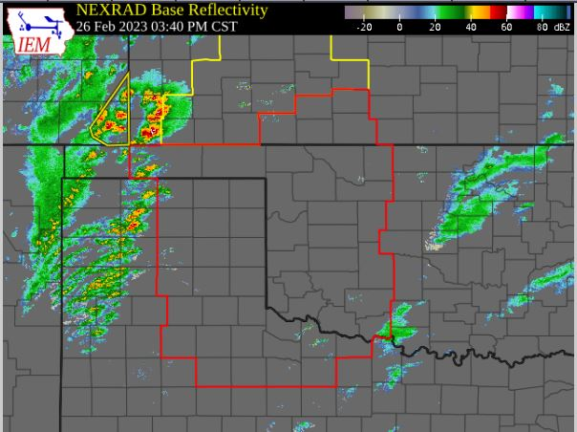
Initial cells developing along the dryline are discrete/semi-discrete!

Slide 24
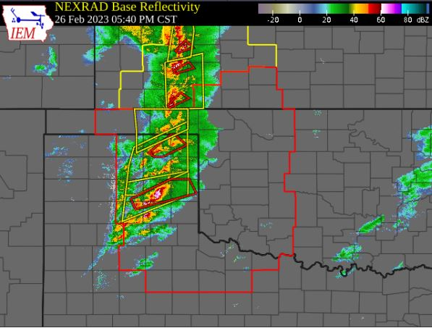
2 hours later… cells remain semi-discrete.
A few tornadoes and 1.5 inch hail are reported…

Slide 25
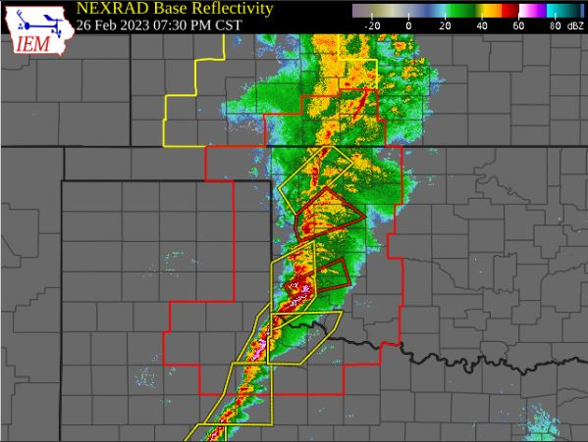
2 hours later…
Squall line with 75-114 mph winds reported.
What changed?

Slide 26
Very strong height falls aloft associated with
the approach of a robust upper wave.
Strong ascent associated with an eastward-moving Pacific cold front
Both of these factors yielded very strong lift along the front, resulting in rapid upscale growth.
2 hours later…
Squall line with 75-114 mph winds reported.
What changed?

Slide 27
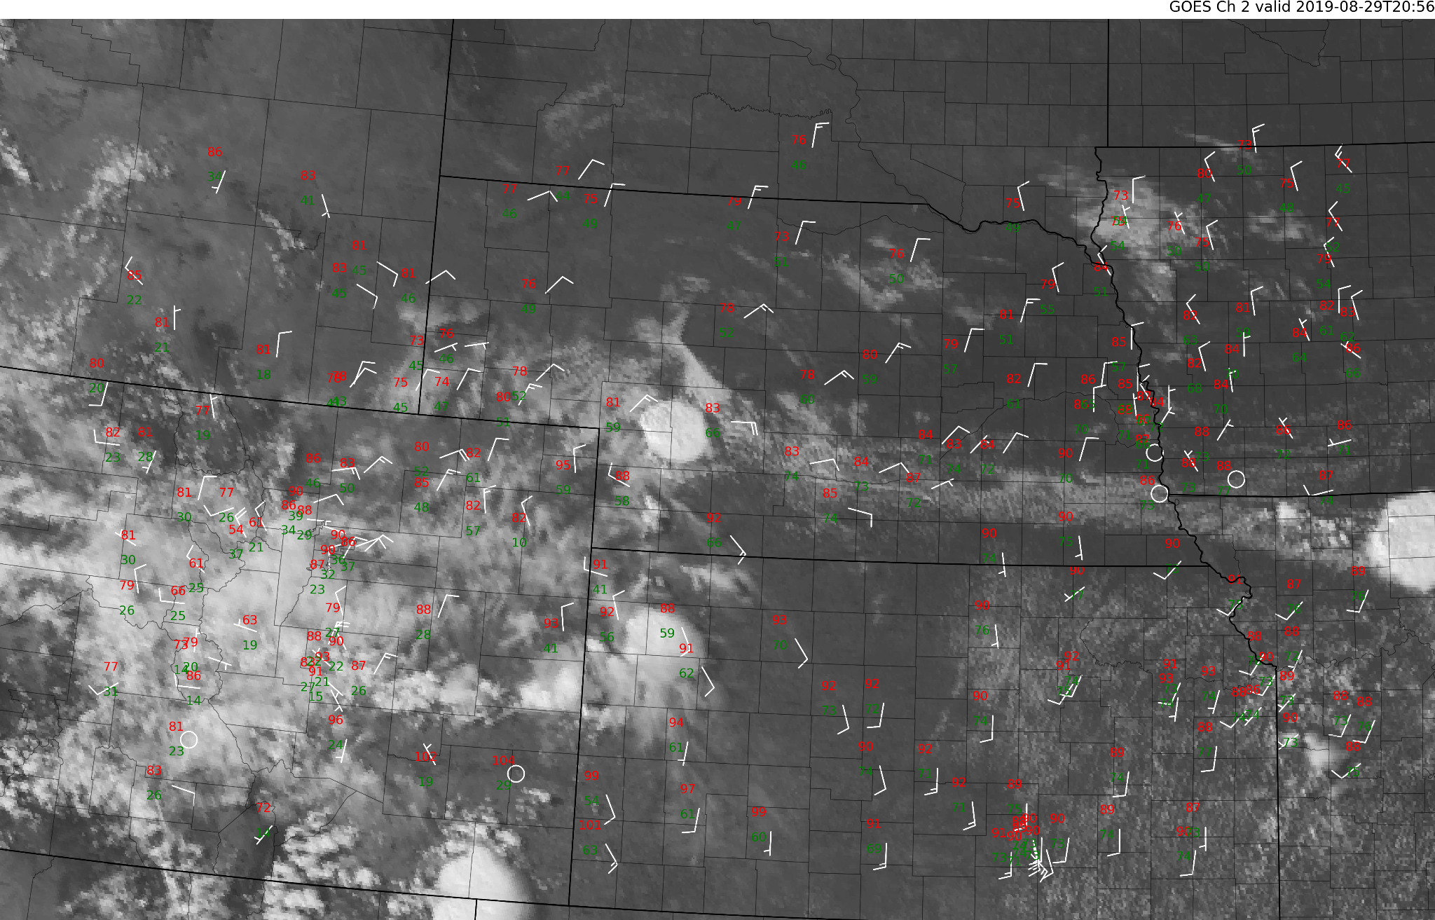
A storm is initiating! What storm mode do you expect…
in the next hour?
in the next 3+ hours?
Case 5

Slide 28
Case 5
Do a rough surface analysis to identify boundaries

Slide 29
Case 5
Consider the following…
Bunker’s Right-moving Storm Motion:
15-20 knots ~135 deg

Slide 30
Case 5
Consider the following…
Effective Bulk Shear:
40 knots ~120 deg

Slide 31
Case 5
Consider the following…
Modified 12z sounding
S.R. Anvil-Level winds:
25 knots @ 135 deg

Slide 32
Case 5
Storm mode assessment for the next hour?

Slide 33
Case 5
Storm mode assessment for the next 3-6 hours?

Slide 34
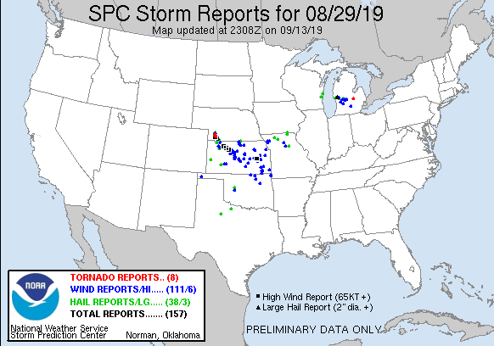
Consider how storm mode relates to convective hazards
00 UTC
Initially discrete
05 UTC
Linear/MCS
Notes:
There were several brief, low-end tornadoes across southwest NE associated with this storm. The storm remained discrete for the first 2-3 hours of its life before additional convection developed nearby. As discussed, the boundary/shear geometry could have supported upscale growth if there was sufficient coverage of storms. In this case, the cluster did grow upscale over time, leading to several wind reports downstream across KS.

Slide 35
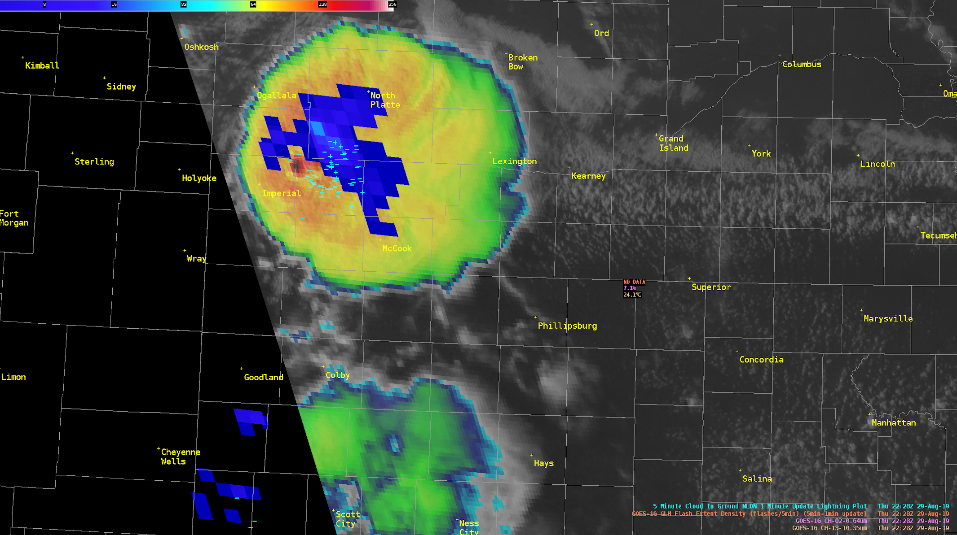
We’re done!
Questions?

